Slide 1
CICD Implementation
Team 21 Spring 2023
Updated: 5/28/2023

Slide 2
Branch Structure Strategy
Two fundamental branches
The main branch
Stores current stable release
Push from dev branch (via pull request) to make a new release
Push directly to main branch for repo-level things (e.g., CI/CD changes, modifications to the README)
Optional – may depend on case-by-case basis (for small changes we just want to commit once without a big headache)
The dev branch
Collective branch for everyone to work on next release
Feature / bug-fix branches come from the dev branch and are merged back via pull-request to add new features / bug fixes to development work

Slide 3
CI / CD Approach
Three unique situations:
Pushing to the main branch
Linting, tests, main branch docs, minimizer, deployment
Pushing to the dev branch
Linting, tests, dev branch docs (stored in a separate folder than main branch docs)
Pushing to other branches / creating a pull request
Linting and tests
Each situation has its own workflow (three .yml files)
Could add more steps / workflows in the future if necessary

Slide 4
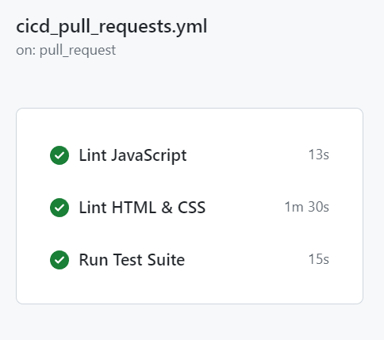
Pushing to other branches / Pull Requests

Slide 5
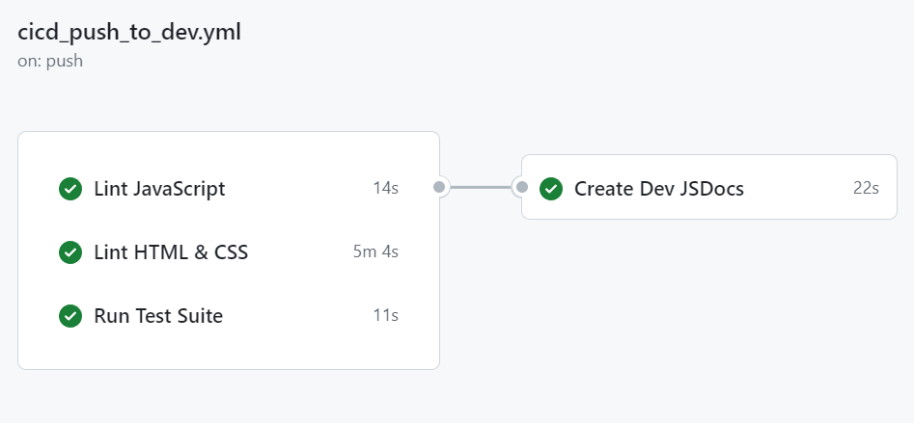
Pushing to dev branch

Slide 6
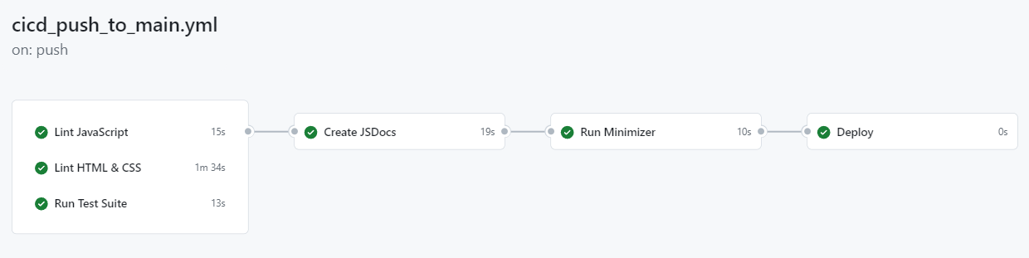
Pushing to main branch

Slide 7
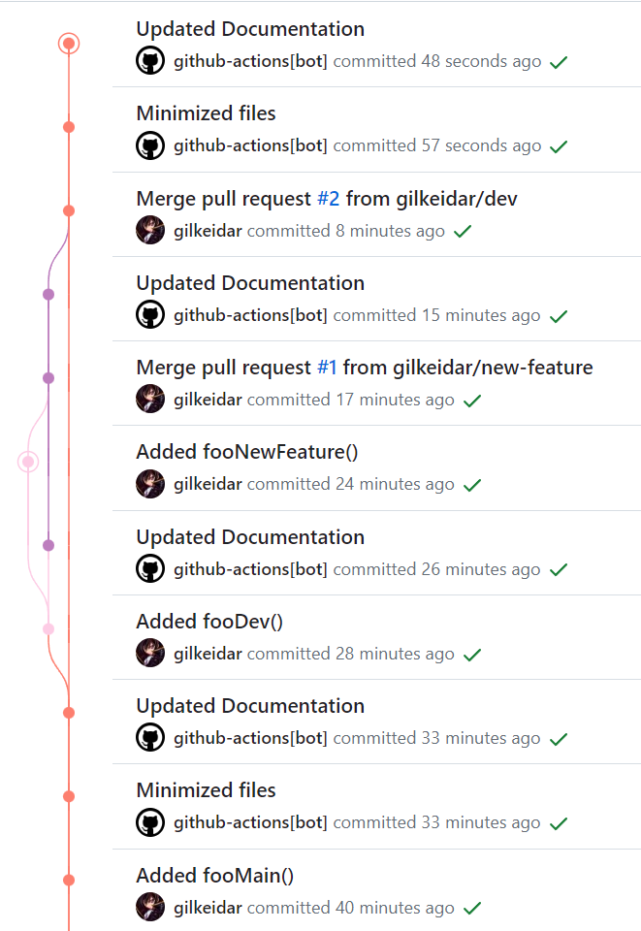

Visualized Commit Work
Push to main: Added fooMain() – triggers push to main workflow
Workflow creates documentation in the docs/ directory and generates minimized code in the dist/ directory (in two separate commits)
Push to dev: Added fooDev() – triggers push to dev workflow
Workflow creates documentation in the dev-docs/ directory
this is done to avoid merge conflicts
dev-docs is deleted from the main branch upon merging dev with main to create a new release
Push to new-feature: Added fooNewFeature() – triggers pull request or general push workflow
Lints JavaScript / HTML / CSS and runs test suite, but that’s it
Pull request from new-feature to dev: Triggers pull request or general push workflow
After the pull request is merged to dev, the push to dev workflow will be run since we’re pushing to dev
Pull request from dev to main: Triggers pull request or general push workflow
After the pull request is merged to main, the push to main workflow will be run since we’re pushing to main

Slide 8
Visualized Commit Work
Push to main: Added fooMain() – triggers push to main workflow
Workflow creates documentation in the docs/ directory and generates minimized code in the dist/ directory (in two separate commits)
Push to dev: Added fooDev() – triggers push to dev workflow
Workflow creates documentation in the dev-docs/ directory
this is done to avoid merge conflicts
dev-docs is deleted from the main branch upon merging dev with main to create a new release
Push to new-feature: Added fooNewFeature() – triggers pull request or general push workflow
Lints JavaScript / HTML / CSS and runs test suite, but that’s it
Pull request from new-feature to dev: Triggers pull request or general push workflow
After the pull request is merged to dev, the push to dev workflow will be run since we’re pushing to dev
Pull request from dev to main: Triggers pull request or general push workflow
After the pull request is merged to main, the push to main workflow will be run since we’re pushing to main

Slide 9
CI / CD Current Steps

Slide 10

Linting - JavaScript
Linter is used to maintain code style throughout our project
JavaScript Linter – Semi-Standard Style
Allows for semi-colons (important for minimizer)
Recommended: Install the Standard Style VSCode Extension
Found here
After installing, go to Extensions > StandardJS – JavaScript Standard Style > Extension Settings and set Standard: Engine to semistandard.
To check that it worked, open a JavaScript file. If the code isn’t in Semi-Standard style, you’ll see lots of red squiggly underlines. Save the file and it should update the code to conform to this style (you may need to save multiple times)

Slide 11

Linting – HTML & CSS
Linter is used to maintain code style throughout our project
HTML & CSS Linter – Super-Linter
Found here
Advantages:
Easy to use – it’s a GitHub Action
Supports lots of languages
Disadvantages:
Slow install time – you can expect it to run for at least 1 minute which slows down the CI/CD pipeline considerably

Slide 12

Testing - Jest
Testing JavaScript files with Jest
Install Jest in the terminal using
npm install --save-dev jest
However, after an initial commit to the repository that contains the package.json and package-lock.json files generated when installing Jest, I believe that you can just pull from the repository and then run npm install instead.
Don’t put your tests in the src folder – otherwise, they’ll be linted by the JavaScript linter during the CI/CD workflows
Instead, put your tests in a tests/ folder outside src/

Slide 13
Documentation - JSDocs
Generates a documentation website (no deployment, however) automatically when you push to dev or to main
The docs generated for the dev branch and the docs generated for the main branch are stored in separate folders.
Can easily configure the template for the documentation website (i.e. its appearance – see here)
To use, use /** JSDoc comment */ in your code (above classes, functions, and variables)
Recommended: use tags and specify the types of parameters:
/**
* Creates a FortuneEngine object.
* @param {string} app_name that gives name of fortune teller type
*/

Slide 14

Minimization
Minimization makes the distributed code smaller by removing whitespace and shortening variable names
Minimized code goes in the dist/ folder
Only gets run when pushing to main

Slide 15
Deployment – ?
Deployment would host our code from the dist/ directory in a way that makes it useable to the user
We have not yet decided how we wish to deploy our project
Possibility: Use GitHub Pages
Advantage: Easy to do
Disadvantage: May be difficult to host the JSDocs documentation website should we want to
(A GitHub repository can only have one GitHub Pages website as far as I am aware)

Slide 16
Let’s take a look at the .yml files

